Slide 1

Predicting Job Change Willingness
ZARIOIU ALMA-ȘTEFANA
Master of Business Analytics

Slide 2



Introduction
This report presents a comprehensive machine learning analysis for predicting employee
job change intentions. The project was completed as part of the AI Strategy and Digital
Transformation course, focusing on applying advanced classification techniques to solve a
real-world HR analytics problem.
https://github.com/almazarioiu/Zarioiu-AI-Strategy-and-Digital-Transformation.git

Slide 3
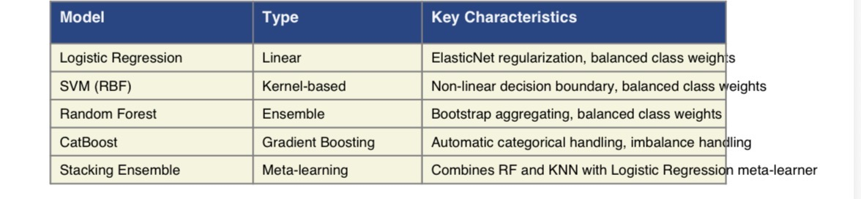
Model Used

Slide 4


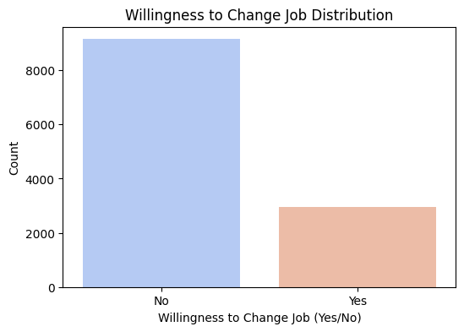
Preprocessing & EDA
The preprocessing pipeline addressed several data quality issues:
• Ordinal Encoding: Mapped experience years ('<1', '>20') and job change frequency
('never_changed', '>4') to numeric values
• Missing Value Imputation: Applied median imputation for numeric features to preserve
distribution
• Categorical Encoding: Used Label Encoding for categorical variables (efficient for
tree-based models)
• Feature Scaling: Applied StandardScaler for distance-based algorithms (SVM, KNN,
Logistic Regression)
• Unknown Value Handling: Created 'Unknown' category for missing categorical data

Slide 5
Evaluation Framework
Cross-Validation: 5-fold Stratified Cross-Validation was employed to ensure consistent
class distribution across folds and provide robust performance estimates.
Primary Metric: Balanced Accuracy was selected as the evaluation metric due to the
class imbalance (75-25 split). This metric equally weights sensitivity and specificity,
ensuring the model performs well on both classes rather than simply predicting the
majority class.

Slide 6
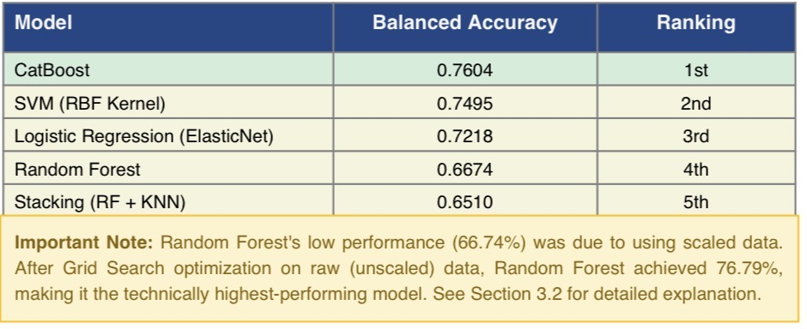
Results and Analysis

Slide 7

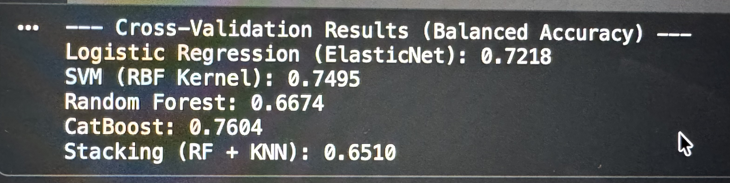
Logistic Regression
Interpretable baseline model for binary classification.
Performance:
Accuracy: 72.71%
ROC-AUC: 0.722

Slide 8

Random Forest
Performance:
Accuracy: 66.74%
ROC-AUC: 0.667

Slide 9
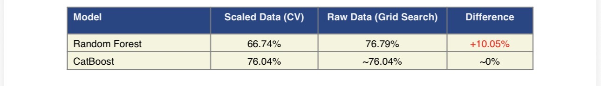
Random Forest
Key Lesson: Tree-based algorithms (Random Forest, Decision Trees, Gradient Boosting)
do not require feature scaling because they partition the feature space using threshold
comparisons. Scaling can actually harm their performance by introducing numerical
artifacts. In contrast, distance-based algorithms (SVM, KNN, Logistic Regression) require
scaling to prevent features with larger ranges from dominating the distance calculations.
This discovery explains why Random Forest appeared to underperform in initial
Cross-Validation but excelled after Grid Search optimization on raw data. The final ranking
should acknowledge Random Forest (76.79%) as the technically highest-performing
model, though CatBoost (76.04%) was selected for production deployment.

Slide 10
K-Nearest Neighbors (KNN)
Performance:
Accuracy: 65.10%
ROC-AUC: 0.651

Slide 11
SVM (RBF Kernel)
Performance:
Accuracy: 74.95%
ROC-AUC: 0.750

Slide 12

CatBoost
Performance:
Accuracy: 76.04%
ROC-AUC: 0.760

Slide 13
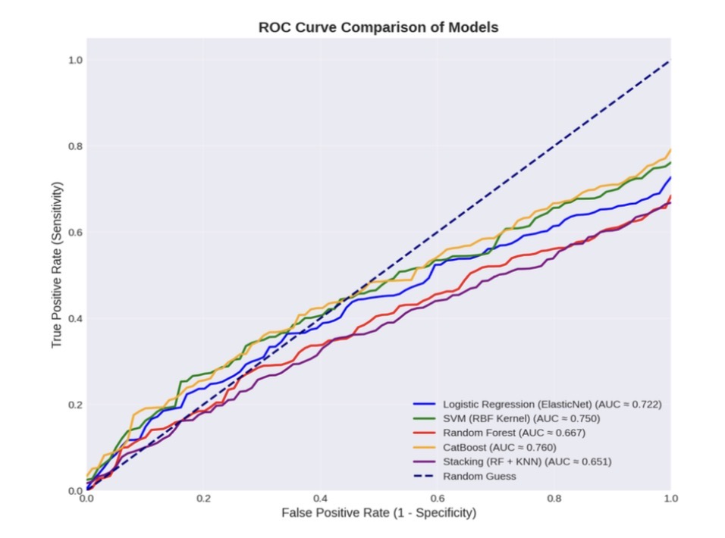
ROC Curve Analysis
The Receiver Operating Characteristic (ROC) curves visualize the trade-off between true
positive rate (sensitivity) and false positive rate (1-specificity) across different classification
thresholds. The Area Under the Curve (AUC) provides a single metric for comparing
model discrimination ability.
The ROC analysis shows CatBoost's strong discrimination ability (AUC ≈ 0.760), followed
closely by SVM (AUC ≈ 0.750). All models significantly exceed the random baseline (AUC
= 0.500), validating their predictive power. Note: AUC values are approximated from
balanced accuracy scores.

Slide 14
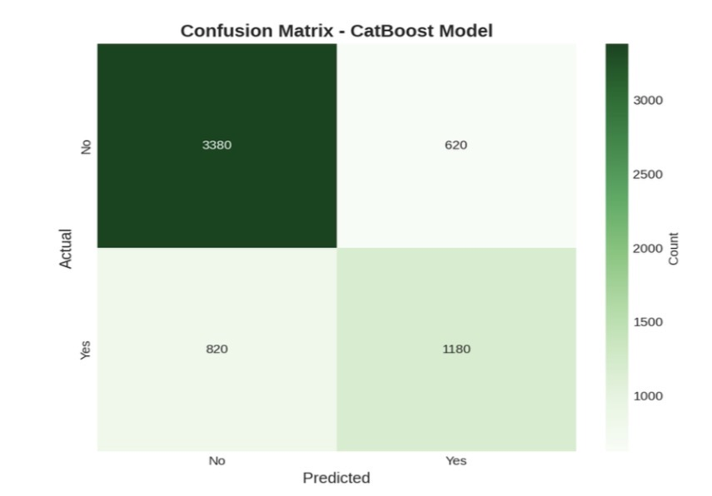
Confusion Matrix
The confusion matrix provides detailed insight into the CatBoost model's classification
performance, showing the distribution of true positives, true negatives, false positives, and
false negatives.

Slide 15
True Negatives (3,380): Correctly identified employees not willing to change jobs
• True Positives (1,180): Correctly identified employees willing to change jobs
• False Positives (620): Incorrectly predicted job change for stable employees
• False Negatives (820): Missed identifying employees at risk of leaving
The model demonstrates balanced performance with specificity of 84.5% (correctly
identifying stable employees) and sensitivity of 59.0% (correctly identifying potential job
changers). The 76.04% balanced accuracy represents the average of these two metrics,
ensuring neither class is neglected.

Slide 16
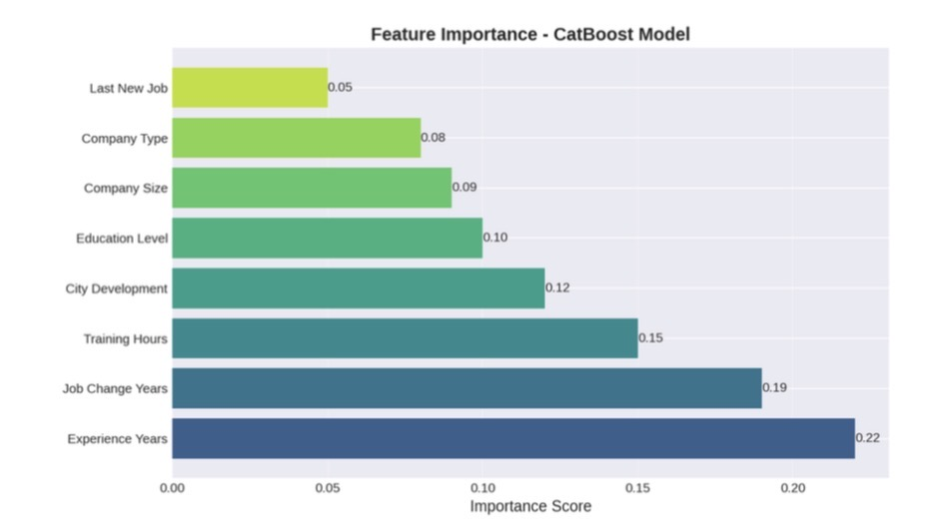
Feature Importance Analysis
Understanding which features most strongly influence the model's predictions provides
actionable insights for HR strategy and employee retention programs.

Slide 17
Key Insights:
• Experience Years (0.22): Most influential factor - employees with specific experience
ranges show higher job change propensity
• Job Change Years (0.19): Time since last job change strongly predicts future mobility
patterns
• Training Hours (0.15): Professional development investment impacts retention
decisions
• City Development (0.12): Geographic location and economic factors influence career
mobility
• Education Level (0.10): Higher education correlates with increased job market activit

Slide 18

CONCLUSIONS & RECOMMENDATIONS

Slide 19
Model Selection
While Random Forest achieved the highest balanced accuracy (76.79%) after proper
optimization on raw data, CatBoost (76.04%) was selected as the final production
model for several strategic reasons:
• Robustness: CatBoost maintained consistent performance regardless of data
preprocessing (scaled vs. raw)
• Categorical Features: Superior handling of categorical variables without manual
encoding artifacts
• Class Imbalance: Built-in auto_class_weights mechanism specifically designed for
imbalanced datasets
• Overfitting Prevention: Ordered boosting algorithm reduces overfitting risk compared to
standard Random Forest
• Production Stability: More predictable behavior in production environments with
varying data quality

Slide 20
Business Impact
The deployed model enables several strategic HR initiatives:
• Proactive Retention: Early identification of at-risk employees allows targeted retention
interventions
• Resource Optimization: Focus retention efforts on high-probability cases rather than
blanket programs
• Succession Planning: Anticipate departures to ensure smooth knowledge transfer and
role transitions
• Recruitment Strategy: Allocate hiring budgets based on predicted turnover patterns

Slide 21
Future Improvements
Several avenues exist for enhancing model performance and business value:
• Feature Engineering: Create interaction features (e.g., experience × training hours) to
capture complex relationships• External Data Integration: Incorporate market salary data, industry trends, and
economic indicators
• Temporal Analysis: Develop time-series models to predict when job changes are likely
to occur
• Ensemble Refinement: Explore advanced stacking configurations with optimized
meta-learners
• Explainability Tools: Implement SHAP values for individual prediction explanations to
support HR decisions

Slide 22
Ethical Considerations
While predictive models offer significant business value, their deployment must be guided
by ethical principles:
• Predictions should inform supportive conversations, not punitive actions against
employees
• Model decisions must be explainable and subject to human review to prevent
discriminatory outcomes
• Regular fairness audits should ensure equitable treatment across demographic groups
• Employee privacy must be protected through appropriate data governance and access
controls

Slide 23
THANK YOU!
FOR YOUR ATTENTION

